Slide 1
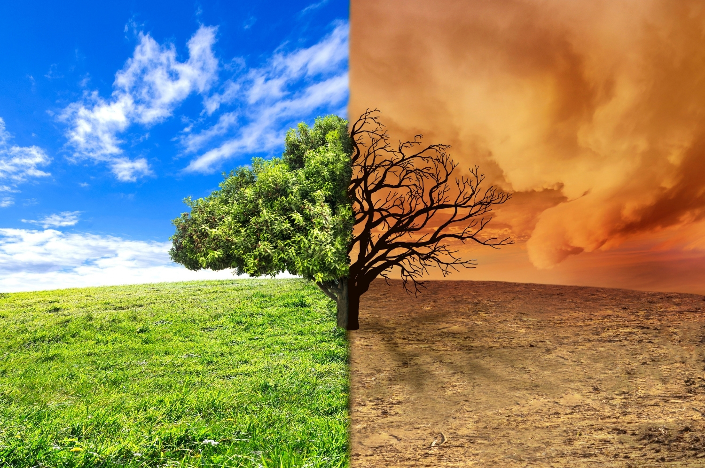


GLOBAL WARMING CAUSES
ECA Project 2023-1-BG01-KA220-SCH-000160813

Slide 2


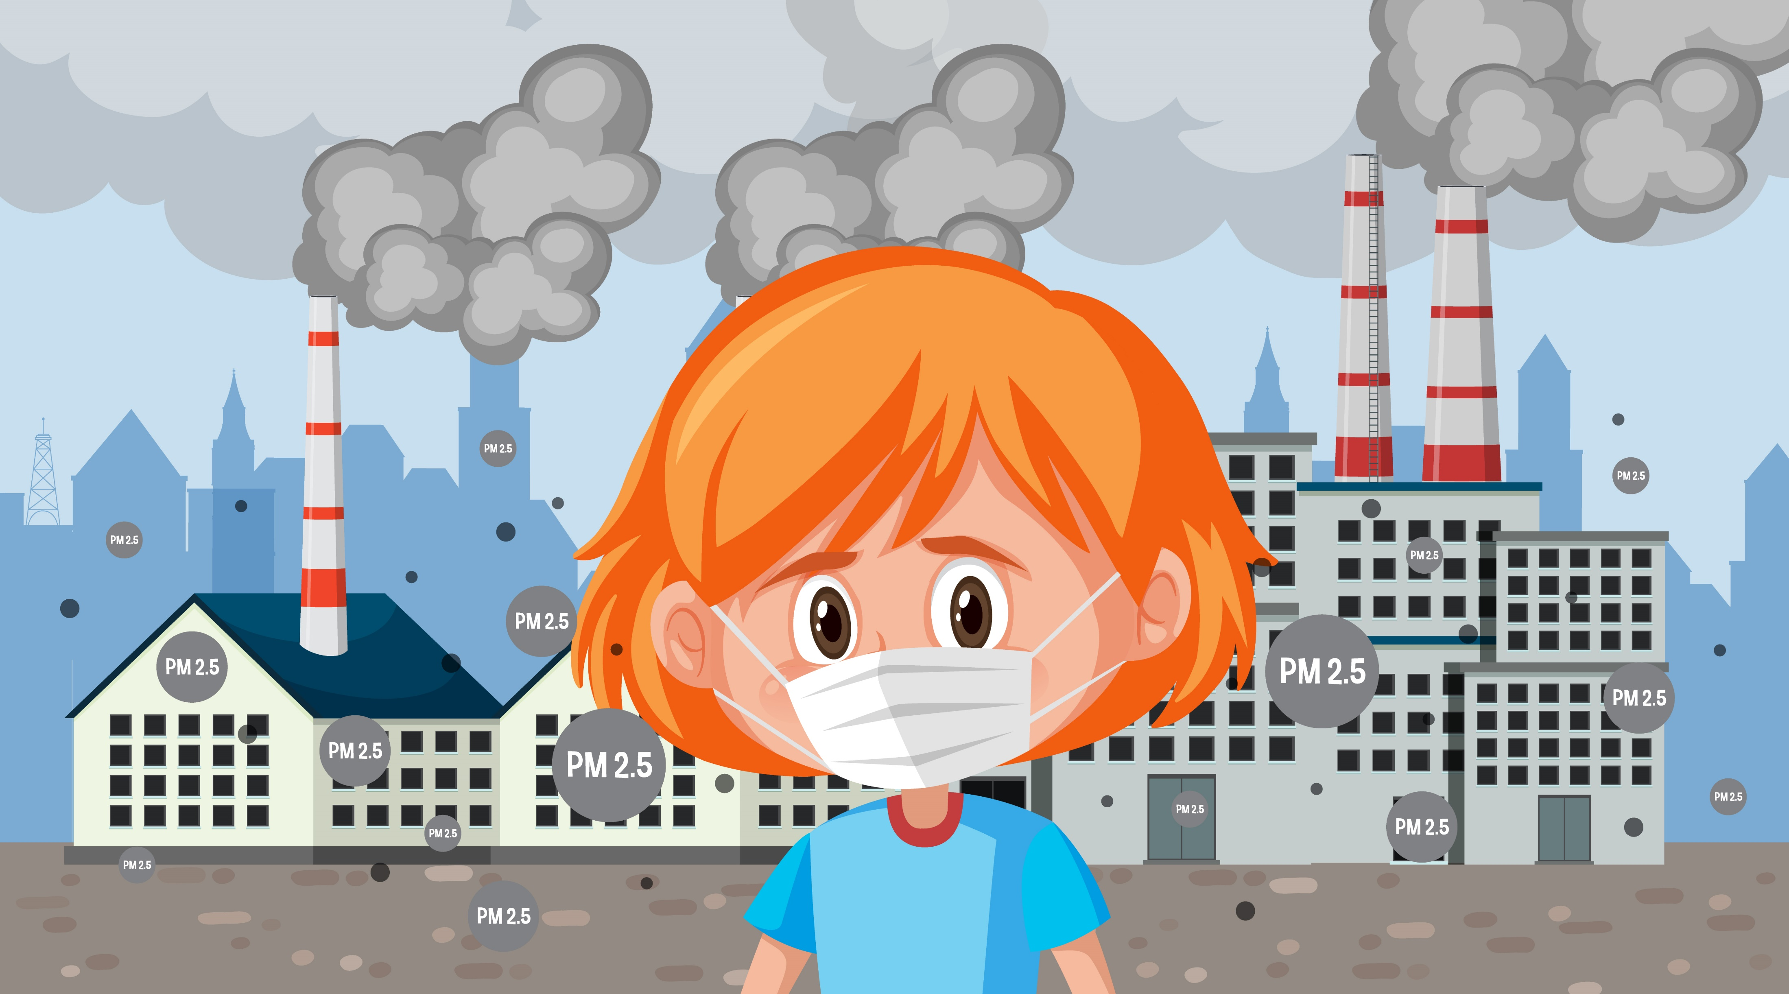
GLOBAL WARMING CAUSES
Air Pollution

Slide 3
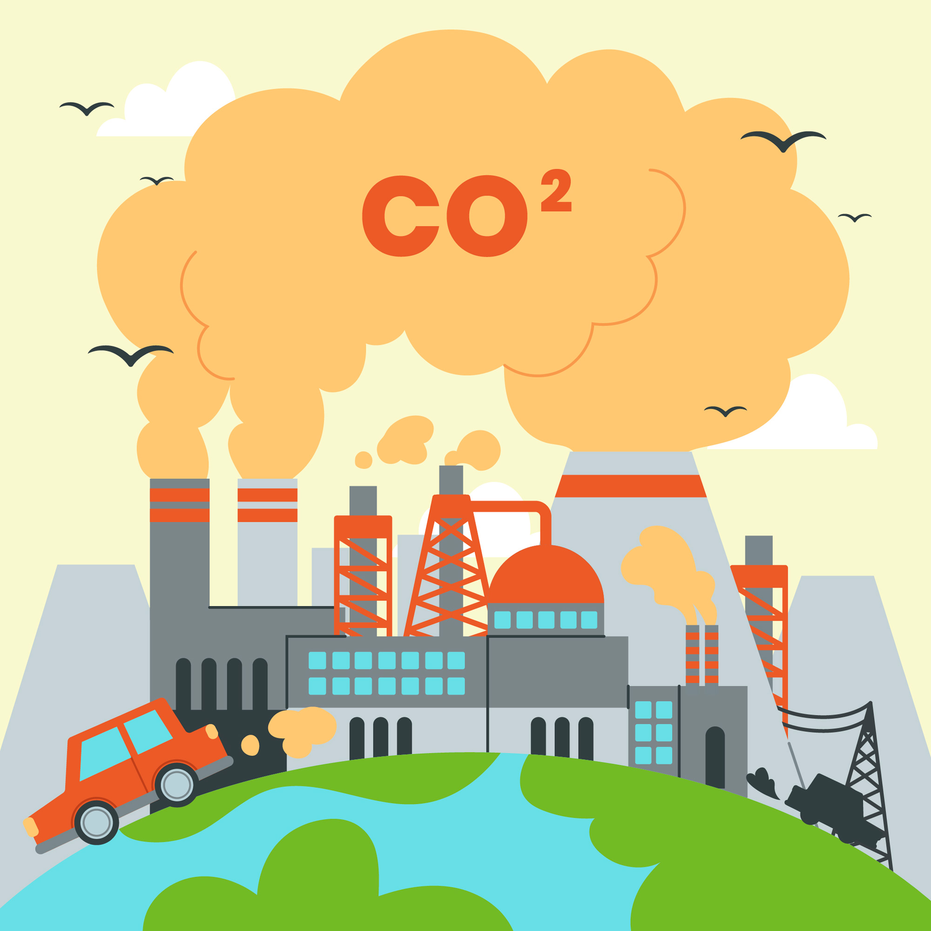
GLOBAL WARMING CAUSES
Carbon dioxide

Slide 4

GLOBAL WARMING CAUSES
Coal

Slide 5
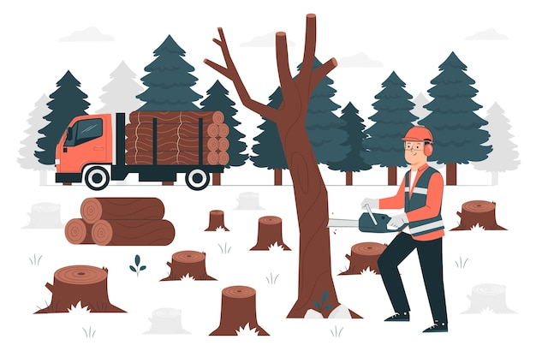
GLOBAL WARMING CAUSES
Deforestation

Slide 6
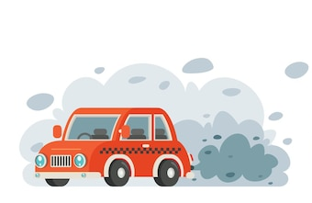
GLOBAL WARMING CAUSES
Emission

Slide 7

GLOBAL WARMING CAUSES
Fossil Fuel

Slide 8

GLOBAL WARMING CAUSES
Greenhouse Effect

Slide 9
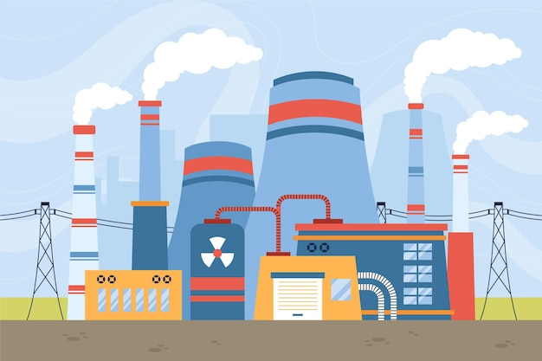
GLOBAL WARMING CAUSES
Industrial Plant

Slide 10
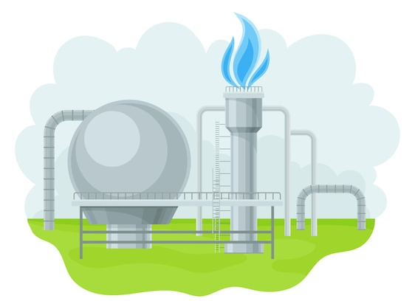
GLOBAL WARMING CAUSES
Natural Gas

Slide 11

GLOBAL WARMING CAUSES
Oil

Slide 12






Module: Ecological awareness
Sub-module: Environmental pollution
Topic: Air and Climate (Global warming)
Resource title: Presentation
Credits: APDNE
2023-1-BG01-KA220-SCH-000160813
All media are within the EU intellectual property law.
Funded by the European Union. Views and opinions expressed are however those of the author(s) only and do not necessarily reflect those of the European Union or the European Education and Culture Executive Agency (EACEA). Neither the European Union nor EACEA can be held responsible for them.

